Slide 1
UE18CS390A – Capstone Project Phase – 1
SEMESTER - VI
END SEMESTER ASSESSMENT
Project Title : PerfectCrop - The right crop for your soil.
Project ID : PW22RBA01
Project Guide : Prof. Raghu B A Rao
Project Team : PES1201800051 Srish Srinivasan
PES1201800089 Akash Kumar Rao
PES1201800102 Vishruth P Reddy
PES1201800291 Ishan Agarwal

Slide 2
Outline
Problem Statement
Abstract and Scope
Literature Survey
Suggestions from Review – 3
Design Approach
Design Constraints, Assumptions & Dependencies
Proposed Methodology / Approach
Architecture
Design Description
Technologies Used
Project Progress
References

Slide 3
Abstract
Our project comes under the domain of Precision Agriculture. It helps farmers make informed decisions with regards to the kind of crop they must invest in to get good returns. The aim of this project is to build a predictive model to recommend the most suitable crop to grow based on the various parameters that influence the fertility of the soil.

Slide 4
Scope
This project enables the farmers to grow the most suitable crop by factoring in various soil characteristics like N (Nitrogen), P (Phosphorus), K (Potassium) contents, pH and atmospheric conditions like temperature, humidity and rainfall. This results in greater yield of crop and therefore, stabilizing their financial status. In this project, the focus is on analyzing the existing data and employing suitable models in order to give the best recommendations possible to the farmers.
Among the 4 data sources we have, one of them is only limited to 22 crops but covers the entire country. The second source is area specific, that is, it has the soil details for 13 districts in the state of Andhra Pradesh consisting of all the nutrient levels and the associated crops grown. The third source of data has all the soil details of Karnataka and the 4th dataset is limited to Mayyil village of Kerala.

Slide 5
Problem Statement
Our project comes under the domain of precision farming. Our aim in this project is to build a recommendation system that recommends the most suitable crop to be grown given the properties of the soil and the surrounding atmospheric conditions of a specific location. We will be narrowing down our focus onto a specific part of India. The properties of the soil that are to be taken into consideration could include its nutrient contents and their quantities.
Soil Macronutrients include N, P, K, Ca, S, Mg, C, O, and H.
Soil Micronutrients include Fe, B, Cl, Mn, Zn, Cu, Mo, and Ni.
On collecting the required data, we plan to use machine learning algorithms in order to build robust models that can make forecasts with a very good accuracy level.

Slide 6
Problem Statement
Precision farming can reduce the quantity of nutrients and other requirements used by a large extent while boosting the yield by a large margin. Farmers can thus obtain great returns on their investments and can also save big on fertilizer, pesticide, water and other resources.
The next big advantage of practicing precision farming is the prevention of malefic impact on our environment by using the right quantity of chemicals and thereby conserving the quality of soil and groundwater.

Slide 7
Problem Statement
We got in touch with Dr.K Ganesha Raj, the General Manager of RRSC South, ISRO seeking for useful data related to our project. They assigned Dr.Ramasubramoniam, Soil and Agri Scientist to guide us through our project. The scientist will be providing us with area specific soil and crop data gathered by ISRO over the past years to carry out our project.
We received the dataset for the state of Kerala from Dr. Ramasubramoniam and have performed some basic analysis in order to understand its usage.

Slide 8

Summary of Literature Survey
Paper1: Keerthan Kumar, T.G., Shubha, C. and Sushma, S.A., Random Forest Algorithm for Soil Fertility Prediction and Grading Using Machine Learning. International Journal of Innovative Technology and Exploring Engineering (IJITEE), 2019.
The authors of [1] have proposed a machine learning based solution for the analysis of imperative soil parameters and their influence on the kind of crops that could be suitably grown in a given soil. The various soil nutrients are treated as the independent variables and the grade of the soil is the target variable. The regression algorithm along with Root Mean Square Error were employed to predict the rank of a soil and on applying a few classification algorithms for the purpose of crop recommendation, they found that Random Forest was the most accurate model.

Slide 9

Summary of Literature Survey
Paper1: Random Forest Algorithm for Soil Fertility Prediction and Grading Using Machine Learning by Keerthan Kumar, T.G., Shubha, C. and Sushma, S.A, 2019.
Module-1: Grading of Soil
The contents of various soil nutrients such as EC, K, pH, Mn, Zn, S, P, and B are considered as the independent variables and the grade of the soil is considered as the target variable. So a Multi-Variate Linear Regression model was built to predict the fertility of soil on a scale of 5. A linear combination of the independent variables was chosen as the hypothesis function. The cost function chosen was:

Slide 10
Summary of Literature Survey
Paper1: Random Forest Algorithm for Soil Fertility Prediction and Grading Using Machine Learning by Keerthan Kumar, T.G., Shubha, C. and Sushma, S.A, 2019.
where
Xi = vector of independent variables
h_{θ} = hypothesis function
Yi = True value of the response variables
m = normalizing parameter
The Gradient Descent algorithms was adopted to minimize the cost function.

Slide 11
Summary of Literature Survey
Paper1: Random Forest Algorithm for Soil Fertility Prediction and Grading Using Machine Learning by Keerthan Kumar, T.G., Shubha, C. and Sushma, S.A, 2019.
Module-2: Crop Recommendation
Machine learning algorithms such as Support Vector Machines, Random Forest Classification and Decision Tree were applied and based on the Root Mean Square Error value the most best model was chosen. This model will then be subjected to evaluation where the accuracy of the model would be determined by passing real time data.

Slide 12
Summary of Literature Survey
Paper1: Random Forest Algorithm for Soil Fertility Prediction and Grading Using Machine Learning by Keerthan Kumar, T.G., Shubha, C. and Sushma, S.A, 2019.
Conclusions from [1] are
In soil grading, Linear Regression was found to be the most efficient algorithm with a very less Root Mean Square Error value.
In the case of crop recommendation, the Random Forest Classifier proved to perform better compared to Support Vector Machine and Gaussian Naive Bayes.

Slide 13
Summary of Literature Survey
Paper1: Random Forest Algorithm for Soil Fertility Prediction and Grading Using Machine Learning by Keerthan Kumar, T.G., Shubha, C. and Sushma, S.A, 2019.
Learnings from [1] are
The Random Forest Algorithm is based on ensemble learning and proved to be a very effective algorithm for classification.
The basic idea is to build multiple decision trees from randomly selected subsets of the data. And then when a new data instance comes in, it is put through all these decision trees and a majority vote is taken in order to give the instance its final classification.

Slide 14
Summary of Literature Survey
Paper1: Random Forest Algorithm for Soil Fertility Prediction and Grading Using Machine Learning by Keerthan Kumar, T.G., Shubha, C. and Sushma, S.A, 2019.
Each tree as individual entities might not be ideal, but overall as a group they can perform really well.
Since there are a large number of trees, the existence of any errors or uncertainties associated with any of the trees are taken care off by this algorithm.

Slide 15
Summary of Literature Survey
Paper 2: Kumar, R., Singh, M.P., Kumar, P. and Singh, J.P., 2015, May. Crop Selection Method to maximize crop yield rate using machine learning technique. In 2015 international conference on smart technologies and management for computing, communication, controls, energy and materials (ICSTM) (pp. 138-145). IEEE.
The authors introduce an algorithm they call ‘CSM- Crop Selection Method’
It Uses:
Summer rainfall depth of every year
Past data of crop yield rate
CSM algorithm works on prediction of crop yield rate based on favorable condition in advance and gives a sequence of crops with highest net yield rate

Slide 16
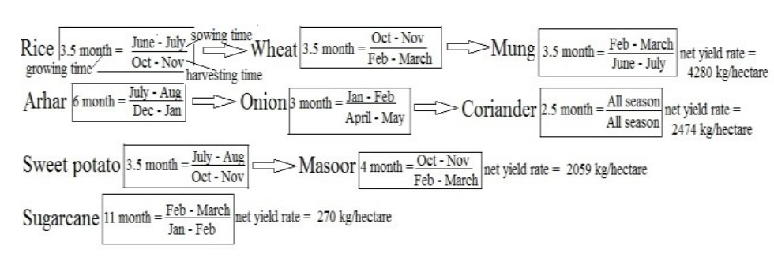
Summary of Literature Survey
Paper 2: Crop Selection Method to maximize crop yield rate using machine learning technique, Kumar, R., Singh, M.P., Kumar, P. and Singh, J.P., 2015.

Slide 17
Summary of Literature Survey
Paper 2: Crop Selection Method to maximize crop yield rate using machine learning technique, Kumar, R., Singh, M.P., Kumar, P. and Singh, J.P., 2015.
Input
crop
their sowing time
plantation days
predicted yield rate for the season
Output
Sequence of crops whose production per day are maximum over season.

Slide 18
Summary of Literature Survey
Paper 3: Palanivel, K. and Surianarayanan, C., 2019. An approach for prediction of crop yield using machine learning and big data techniques. International Journal of Computer Engineering and Technology, 10(3), pp.110-118.
In this paper, the authors have given a detailed description on how various machine learning models are used to predict different crop yields. Since the productivity of the crops is significantly influenced by weather and non-weather parameters, early prediction of yield would facilitate the farmers to make precautionary actions to improve productivity.

Slide 19
Summary of Literature Survey
Paper 3: An approach for prediction of crop yield using machine learning and big data techniques, Palanivel, K. and Surianarayanan, C., 2019.
Meteorological conditions, such as precipitation, temperature, soil conditions, topography and socio-economic factors are responsible for about 30% growth of the crops. Hence, early prediction is possible through collection of previous experience of the farmers, weather conditions and other influencing factors.

Slide 20
Summary of Literature Survey
Paper 3: An approach for prediction of crop yield using machine learning and big data techniques, Palanivel, K. and Surianarayanan, C., 2019.
The paper shows that:
Tea crop yield is best predicted using multiple linear regression.
Maize and wheat yield is predicted using ANN due to the presence of non-linear and inaccurate data.

Slide 21
Summary of Literature Survey
Paper 3: An approach for prediction of crop yield using machine learning and big data techniques, Palanivel, K. and Surianarayanan, C., 2019.
SVM is used to distinguish between weed and crop due to its less vulnerability to overfitting issues. This model best predicts the paddy yield as only a few parameters are necessary for the prediction.
Although different machine learning models are used to predict various crop yields, the selection of the model is based on certain performance metrics.

Slide 22
Summary of Literature Survey
Paper 3: An approach for prediction of crop yield using machine learning and big data techniques, Palanivel, K. and Surianarayanan, C., 2019.
This accuracy is validated by various methods like Mean Squared Error (MSE), Root Mean Squared Error (RMSE) and Mean Absolute Error (MAE).
The following metrics are used to calculate the accuracy of the machine learning models:

Slide 23
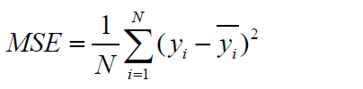

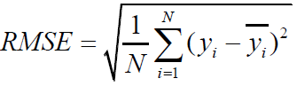
Summary of Literature Survey
Paper 3: An approach for prediction of crop yield using machine learning and big data techniques, Palanivel, K. and Surianarayanan, C., 2019.

Slide 24
Summary of Literature Survey
Paper 3: An approach for prediction of crop yield using machine learning and big data techniques, Palanivel, K. and Surianarayanan, C., 2019.
Inputs to the models
for prediction are:
Weather Inputs
Rainfall
Temperature
Humidity
Non-weather Inputs
Soil Moisture
pH
Salts in soil like N, P, K, C, Ca, Mg, S etc
Crop type
Seed variety

Slide 25
Summary of Literature Survey
Paper 3: An approach for prediction of crop yield using machine learning and big data techniques, Palanivel, K. and Surianarayanan, C., 2019.
Output of the analysis is the crop yield for the provided surrounding conditions.

Slide 26
Summary of Literature Survey
Paper 4: Patil, A., Kokate, S., Patil, P., Panpatil, V. and Sapkal, R., 2020. Crop Prediction using Machine Learning Algorithms. International Journal of Advancements in Engineering & Technology, 1(1), pp.1-8.
In this paper, the authors have taken into account the different ML algorithms which are used in crop prediction over various other studies and have tried to add more attributes to the system in order to improve the results . They have compared the prediction of the ideal crop from using different models to get a better understanding of how to use ML techniques in the future.

Slide 27
Summary of Literature Survey
Paper 4: Crop Prediction using Machine Learning Algorithms, Patil, A., Kokate, S., Patil, P., Panpatil, V. and Sapkal, R., 2020.
The method of crop prediction identified by the authors based on previous work done ,the crop selection method distributes crops into
Seasonal
Whole Year
Short plantation period

Slide 28
Summary of Literature Survey
Paper 4: Crop Prediction using Machine Learning Algorithms, Patil, A., Kokate, S., Patil, P., Panpatil, V. and Sapkal, R., 2020.
The data of these were then taken over a particular region(as agriculture depends on the type of place) and then a suitable crop is selected to be planted.The previous work the authors surveyed made use of ML algorithms with one attribute and thus they made a system to add more attributes to it so that along with crop ,the time of the year and the weather prediction is also taken into account.This is shown in their work flowchart below

Slide 29
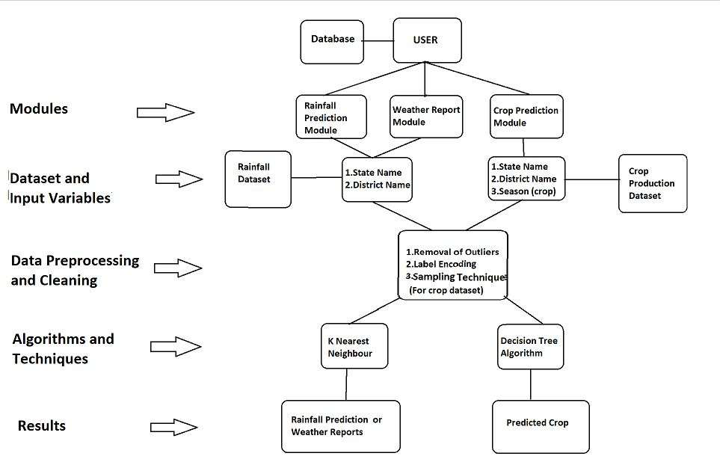
Summary of Literature Survey
Paper 4: Crop Prediction using Machine Learning Algorithms, Patil, A., Kokate, S., Patil, P., Panpatil, V. and Sapkal, R., 2020.

Slide 30
Summary of Literature Survey
Paper 4: Crop Prediction using Machine Learning Algorithms, Patil, A., Kokate, S., Patil, P., Panpatil, V. and Sapkal, R., 2020.
The data must include:
Soil Parameters like soil type, soil pH value
Climatic Parameters like humidity, temperature, wind, rainfall
Production cost of cultivation

Slide 31
Summary of Literature Survey
Paper 4: Crop Prediction using Machine Learning Algorithms, Patil, A., Kokate, S., Patil, P., Panpatil, V. and Sapkal, R., 2020.
Previous year yield details for that region.
The data is preprocessed and fed into KNN , Decision tree and Naive Bayes classifier and the results from both of these are compared.
The selection attributes of the Decision tree being Gini index,entropy and information gain.

Slide 32
Summary of Literature Survey
Paper 4: Crop Prediction using Machine Learning Algorithms, Patil, A., Kokate, S., Patil, P., Panpatil, V. and Sapkal, R., 2020.
After studying the results from the three models , the conclusion obtained is that Decision tree shows poor performance when dataset is having more variations but naïve bayes provides better result than decision tree for such datasets.The combination classification algorithm like naïve bayes and decision tree classifier are better performing than use of single classifier model.
Thus we can make use of this study and also cross check the findings when using different models.

Slide 33
Literature Survey Comparison
Paper1: Random Forest Algorithm for Soil Fertility Prediction and Grading Using Machine Learning by Keerthan Kumar, T.G., Shubha, C. and Sushma, S.A, 2019. Algorithm used: Multivariate Linear Regression, Random Forest Classifier | Paper 2: Crop Selection Method to maximize crop yield rate using machine learning technique, Kumar, R., Singh, M.P., Kumar, P. and Singh, J.P., 2015 Algorithms used: ANN, SVM, KNN, Decision Trees, Random Forest, Gradient Boosted Decision Tree (GBDT), Regularized Greedy Forest (RGF).
Paper 3: AN APPROACH FOR PREDICTION OF CROP YIELD USING MACHINE LEARNING AND BIG DATA TECHNIQUES, Palanivel, K. and Surianarayanan, C., 2019. Algorithm used: Multiple Linear Regression, ANN, SVM. | Paper 4: Crop Prediction using Machine Learning Algorithms, Patil, A., Kokate, S., Patil, P., Panpatil, V. and Sapkal, R., 2020. Algorithms used: KNN , Decision tree and Naive Bayes classifier.

Slide 34
Suggestions from Review - 3
The panel members suggested us to go ahead and start off with the implementation of our project upon receiving the data.

Slide 35
Design Constraints, Assumptions & Dependencies
Our current model factors in all the soil and atmospheric details of the entire country and predicts the output of the crop. After going through literature surveys related to our line of work, we have found out that focusing on a smaller area of interest leads to more accurate results.
Since the values are to be manually entered by the users, they must make sure that they enter it correctly or else the model will lead to wrong predictions and will result in low produce.
Another assumption is that N, P, K and other soil nutrients values are available for the smooth working of the model.

Slide 36
Design Constraints, Assumptions & Dependencies
Other necessary dependencies are:
Good quality network connection to use the web application
Good quality network connection to install the mobile application
After the installation is complete, network connection is not required to make use of the application.
A minimum of 4 GB of RAM is a must for the smooth functioning of the application.
The mobile must have Android as its operating system.

Slide 37
Proposed Methodology / Approach
We are following the waterfall model approach as:
Requirements are fixed and will in all probability remain the same
No ambiguity in the requirements
The technology to be used is well understood
It is a short project with a duration of 6 months
If any need arises in the future to add an additional component to the current project, then we will be switching to an incremental approach and in turn will be following the waterfall model for each of these increments.

Slide 38
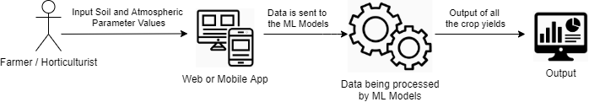
Architecture (if applicable)

Slide 39
Architecture (if applicable)
The following user groups can make use of our application:
Farmers and Horticulturists.
Surveyors and Government officials
Researchers.
Notes:
Farmers and horticulturists can use this application to maximise their profits and land use which will eventually lead to betterment of the nation’s Agriculture Industry’s growth.
Surveyors and Government officials who want these predictions about crops for extensive areas at once. These predictions can also be used to generate revenue estimates and design budgets accordingly.
and lastly the Researchers who need data for future projects.

Slide 40
Architecture (if applicable)
The application components of our project are:
Web application
Mobile application
The data components of our project are:
AP Primary Sector Farmerwise Soil Health Data of 13 districts
User input

Slide 41
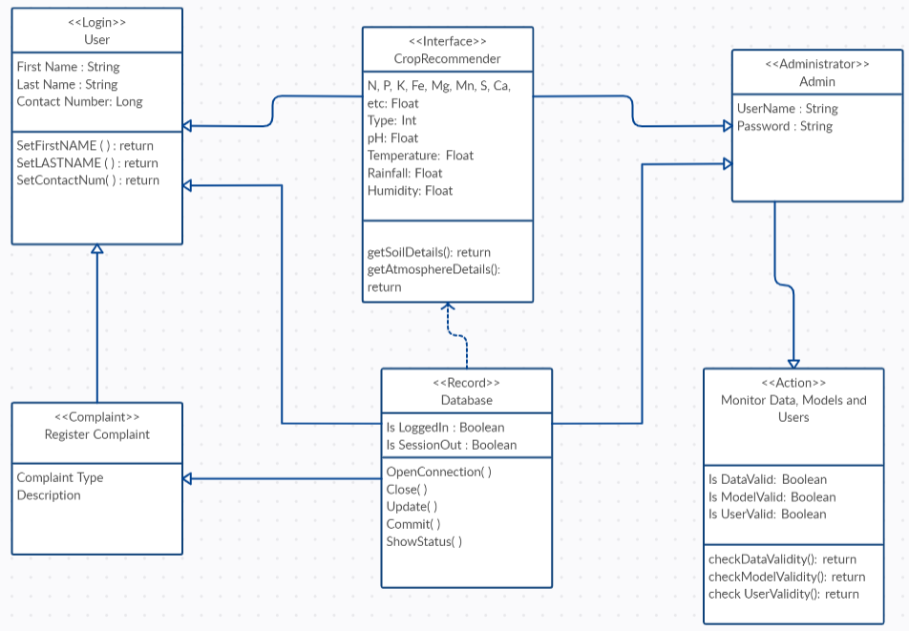
Design Description: Master class diagram

Slide 42
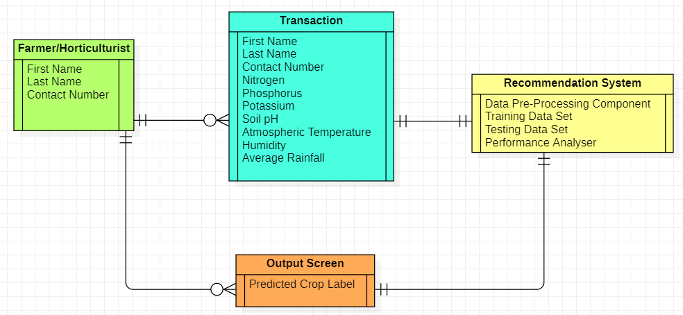
Design Description: ER Diagram

Slide 43
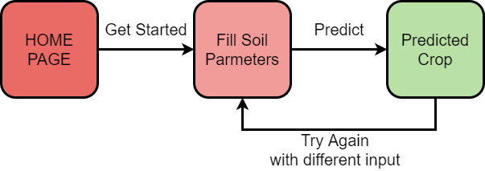
Design Description: User Interface Diagram

Slide 44
Design Description: External Interfaces
Data obtained from:
data.gov.in
ISRO
Kaggle

Slide 45
Technologies Used
Currently, we have implemented 4 machine learning algorithms namely Decision Trees, K-Nearest Neighbors, Naïve Bayes Classifier and Random Forest Classifier. Among these models, the Naïve Bayes Classifier gave the maximum accuracy of 99.47%.
We will make an attempt to implement some of the ensemble machine learning algorithms such as AdaBoost and XGBoost and also an Artificial Neural Networks model in order to achieve the recommendation of crops with a good accuracy score.

Slide 46
Project Progress
Through the literature survey that we conducted, we learnt about the various machine learning algorithms that have been employed to recommend the most suited crop given the required soil and atmospheric properties of a specific location.
We have also implemented 4 machine learning algorithms namely Decision Trees, K-Nearest Neighbors, Naïve Bayes Classifier and Random Forest Classifier. Among these models, the Naïve Bayes Classifier gave the maximum accuracy of 99.47 %.

Slide 47
Project Progress
We have completed about 35% of the project.
In phase-2 of this project, we will make an attempt to implement the ensemble machine learning algorithms such as AdaBoost and XGBoost and also an Artificial Neural Networks model in order to achieve the recommendation of crops with a good accuracy score.
On completing the implementation of these models, we will be building a website and an associated mobile application in order to enable access to this crop recommendation system with user friendly and elegant graphical user interface.

Slide 48
Walkthrough
We have implemented 4 machine learning models. They are
Decision Tree
K-Nearest Neighbours
Naive Bayes
Random Forest
The above mentioned models were implemented on the dataset that we had obtained from Kaggle.

Slide 49
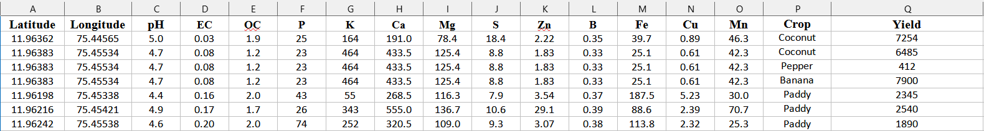
Walkthrough
As mentioned in our previous review, Mr. Ramasubramoniam, the scientist from ISRO RRSC provided us with a dataset for the state of Kerela. It consists of 150 rows and 17 columns.
A small snippet of the dataset is as follows.

Slide 50
Walkthrough (Kerala Dataset Characteristics)
 | pH | EC | OC | P
Mean | 5.02 | 0.12 | 1.47 | 49.53
Mode | 4.71 | 0.103 | 1.45 | 26
Median | 4.95 | 0.101 | 1.48 | 41
First Quartile | 4.65 | 0.079 | 1.26 | 31
Third Quartile | 5.35 | 0.13 | 1.72 | 58
Standard Deviation | 0.53 | 0.065 | 0.33 | 28.38
Range | 2.51 | 0.53 | 1.75 | 139
Minimum | 4 | 0.03 | 0.49 | 21
Maximum | 6.51 | 0.56 | 2.24 | 160
Count | 149 | 149 | 149 | 149

Slide 51
Walkthrough (Kerala Dataset Characteristics)
 | K | Ca | Mg | S
Mean | 132.69 | 346.95 | 106.99 | 14.49
Mode | 108.64 | 125.5 | 62.57 | 8.75
Median | 100.8 | 309 | 95.68 | 13.38
First Quartile | 61.6 | 193 | 61.05 | 10.38
Third Quartile | 161.28 | 448 | 136.69 | 16
Standard Deviation | 114.31 | 190.57 | 70.86 | 5.76
Range | 697.76 | 1020 | 523.36 | 35.25
Minimum | 8.96 | 86 | 6.38 | 3.5
Maximum | 706.72 | 1106 | 529.74 | 38.75
Count | 149 | 149 | 149 | 149

Slide 52
Walkthrough (Kerala Dataset Characteristics)
 | Zn | B | Fe | Cu
Mean | 4.78 | 0.54 | 200.45 | 6.62
Mode | 3.15 | 0.33 | 25.12 | 0.61
Median | 3.54 | 0.36 | 125.38 | 5.59
First Quartile | 2.83 | 0.33 | 86.5 | 3.79
Third Quartile | 5.32 | 0.42 | 219.65 | 8.24
Standard Deviation | 4.28 | 0.76 | 198.24 | 4.06
Range | 4.68 | 4.15 | 863.21 | 29.29
Minimum | 1.54 | 0.22 | 7.36 | 0.61
Maximum | 35.42 | 4.375 | 870.57 | 29.9
Count | 149 | 149 | 149 | 149

Slide 53
Walkthrough (Kerala Dataset Characteristics)
 | Mn | Yield
Mean | 63.56 | 3044.66
Mode | 42.26 | 2200
Median | 45.53 | 2150
First Quartile | 31.38 | 1800
Third Quartile | 70.76 | 2400
Standard Deviation | 56.62 | 4180.40
Range | 283.72 | 34588
Minimum | 6.17 | 412
Maximum | 289.89 | 35000
Count | 149 | 149

Slide 54
Walkthrough (Kerala Dataset Characteristics)
Crop Label | Count
Coconut | 6
Pepper | 1
Banana | 3
Paddy | 104
Bitter gourd | 2
Cucurbit | 1
Bhendi | 3
Cowpea | 9
Brinjal | 7
Tapioca | 3
Crop Label | Count
Tomato | 1
Arecanut | 3
Rubber | 6

Slide 55
Summary of work done in Capstone Phase-1
Through the literature survey that we conducted, we learnt about the various machine learning algorithms that have been employed to recommend the most suited crop given the required soil and atmospheric properties of a specific location.
We have also implemented 4 machine learning algorithms namely Decision Trees, K-Nearest Neighbors, Naïve Bayes Classifier and Random Forest Classifier. Among these models, the Naïve Bayes Classifier gave the maximum accuracy of 99.47 %.
On thorough searching, we also came across a relevant dataset for the state of Andhra Pradesh covering 13 districts.

Slide 56
Project Plan for Capstone Phase-2
In phase-2 of this project, we will make an attempt to implement some of the ensemble machine learning algorithms such as AdaBoost and XGBoost and also an Artificial Neural Networks model in order to achieve the recommendation of crops with a accuracy score.
On completing the implementation of these models, we will be building a website and an associated mobile application in order to enable access to this crop recommendation system with user friendly and elegant graphical user interface.

Slide 57
References
[1] Keerthan Kumar, T.G., Shubha, C. and Sushma, S.A., Random Forest Algorithm for Soil Fertility Prediction and Grading Using Machine Learning. International Journal of Innovative Technology and Exploring Engineering (IJITEE), 2019.
[2] Kumar, R., Singh, M.P., Kumar, P. and Singh, J.P., 2015, May. Crop Selection Method to maximize crop yield rate using machine learning technique. In 2015 international conference on smart technologies and management for computing, communication, controls, energy and materials (ICSTM) (pp. 138-145). IEEE.

Slide 58
References
[3] Palanivel, K. and Surianarayanan, C., 2019. An approach for prediction of crop yield using machine learning and big data techniques. International Journal of Computer Engineering and Technology, 10(3), pp.110-118.
[4] Patil, A., Kokate, S., Patil, P., Panpatil, V. and Sapkal, R., 2020. Crop Prediction using Machine Learning Algorithms. International Journal of Advancements in Engineering & Technology, 1(1), pp.1-8.

Slide 59
Thank You

